Slide 1


TATA DATA VISULAIZATION

Slide 2

INTRODUCTION
Hello and welcome. In this presentation. I will take you through our company sales performance for the years 2010 and 2011.
I appreciate the opportunity you gave me to dive into this data to gain insightful information about the store’s performance .
Thank you also for the questions you asked since they provided a general direction for the kind of insights you are looking to get from this analysis.

Slide 3

Thought Process
I assure you that I took all the necessary steps to ensure that this analysis is accurate and correct.
I cleaned up the data you provided by removing all the negative values in the Unit Price and the Quantity columns and also the filtered data as required for all the visualizations.

Slide 4
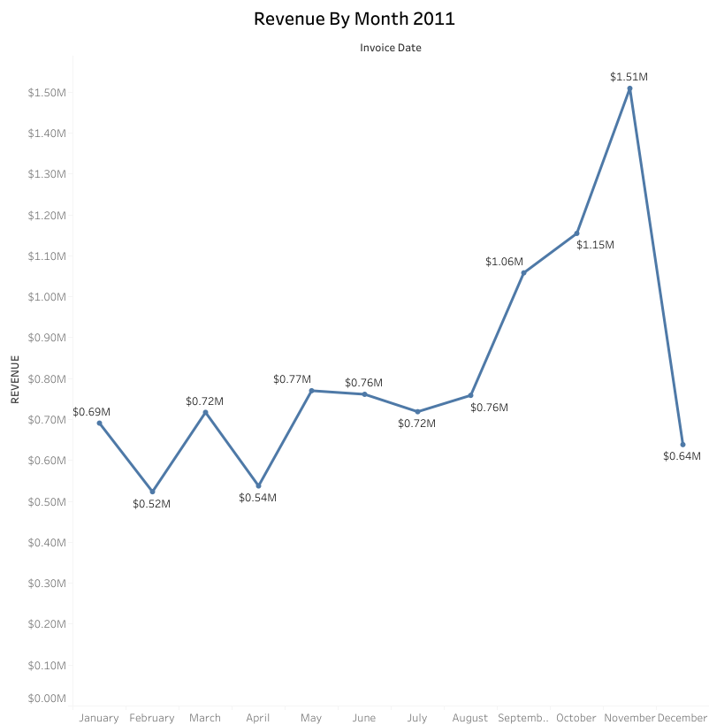
REVENUE BY MONTH 2011
The first 3 months had a stable monthly revenue with an average of $685,000.
We had a significant increase in revenue from September with the revenue peaking at $1.51 Million in November and an average of 21.18% increase in revenue from August to November.
The revenue trend from august to December demonstrates hoe seasonality affect retail store sales .

Slide 5
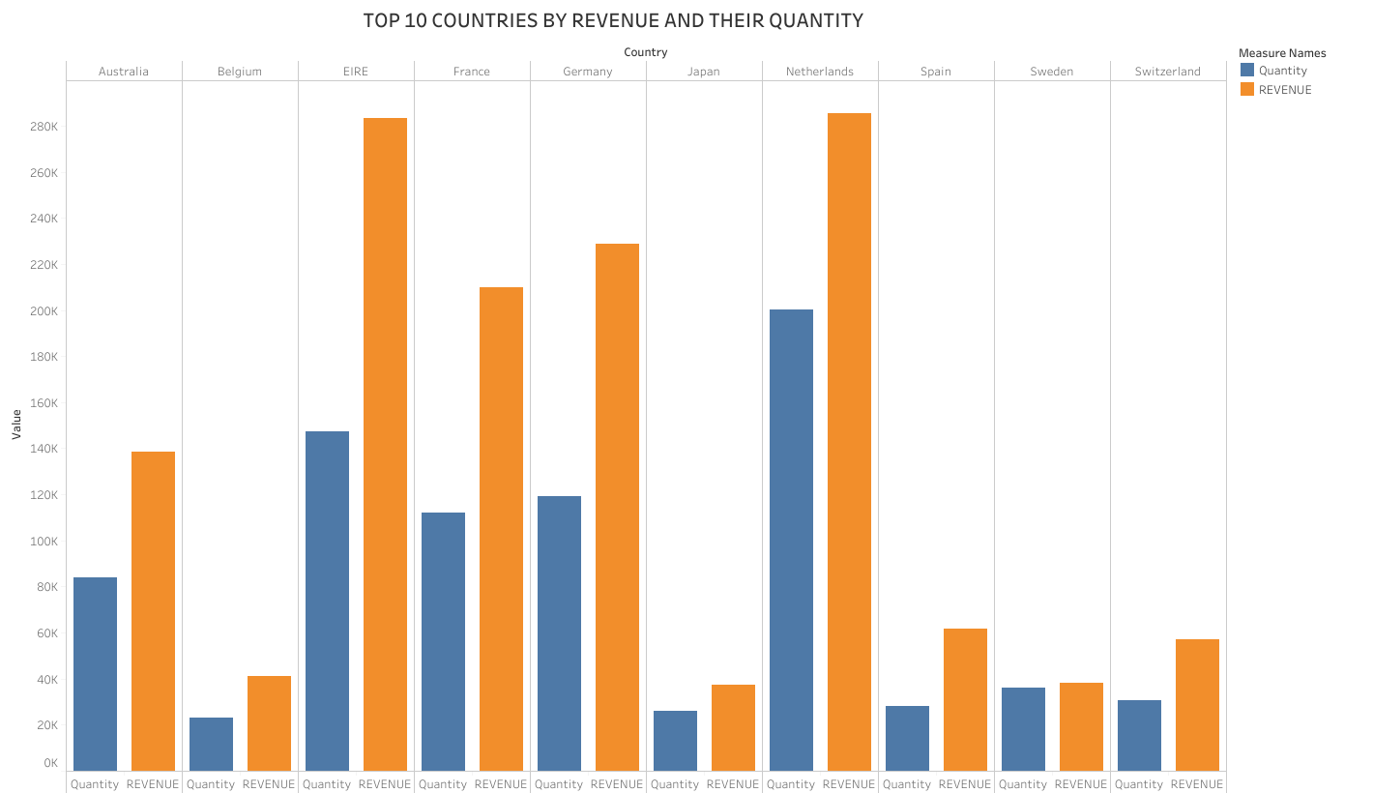
This chart represents the top 10 countries by revenue and the quantities bought in these countries except The United Kingdom. There is no major difference between the revenue and the quantity of goods sold in these countries, showing a high purchasing power in these countries. These countries represent regions with the highest potential to generate more revenue that management needs to focus more on in terms of marketing strategies.

Slide 6
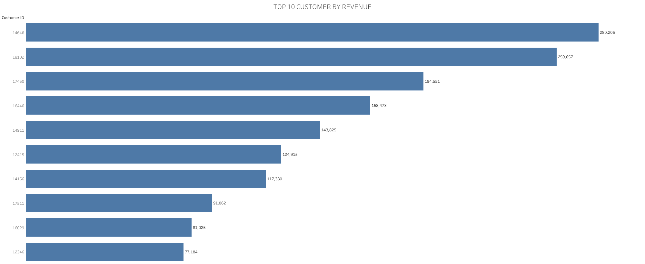
There is no major difference between the Top 10 customers in terms of revenue generated.
The average difference in revenue between the top 10 customers is 15.8%.
The company can aim to strengthen the relationship with customers to increase customer loyalty and retention, and ultimately drive more sales and revenue for the company.

Slide 7
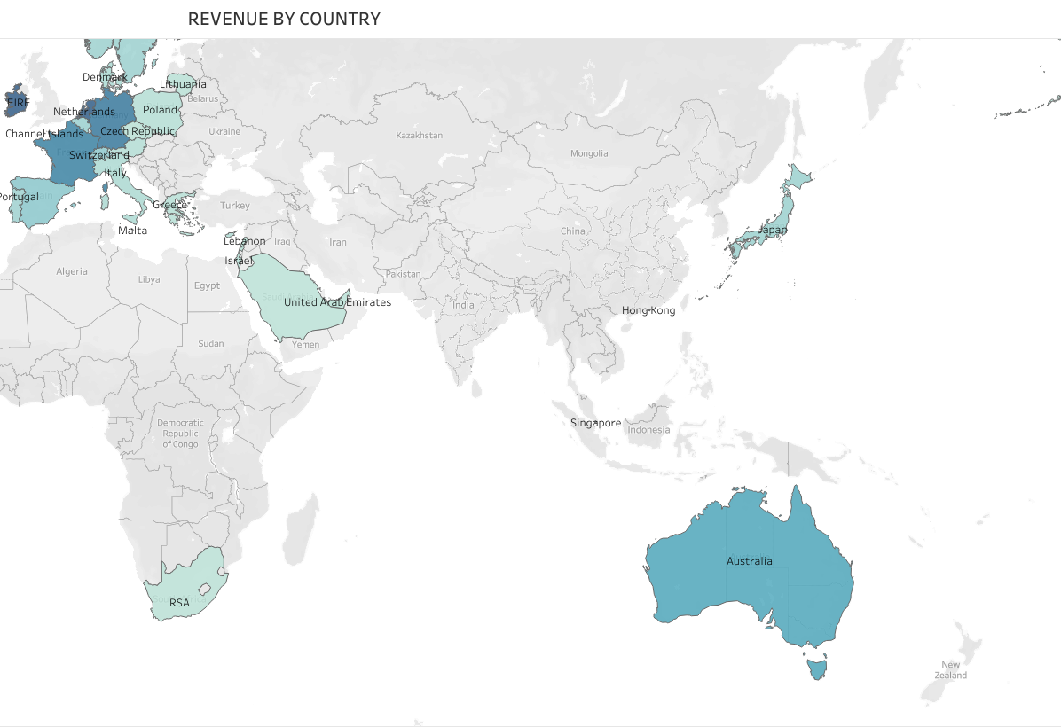
REVENUE BY COUNTRY
The map chart concludes by comparing the places that have produced the greatest revenue to those that have not.
The map also reveals that the majority of sales occur only in the European Zone, with only a small number in the American region.
Along with Russia, there is no market for the items in Africa or Asia.
The company can concentrate on the European market more and dive deeper into counties in the region to come up with strategies that will maximize sales from each country in the region alongside Australia and Japan .

